Slide 1
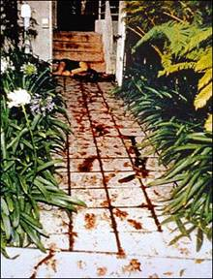
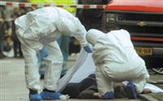
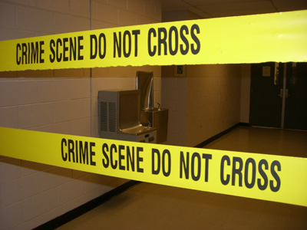
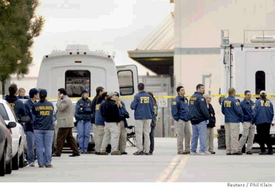
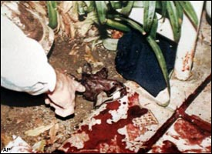

Processing the Crime Scene

Slide 2
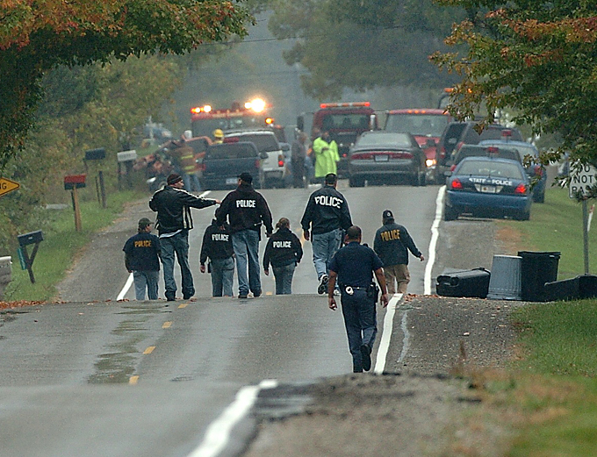

Processing the
Crime Scene
PPPSCRIPT
Mnemonic device to remember steps
ROY G BIV

Slide 3
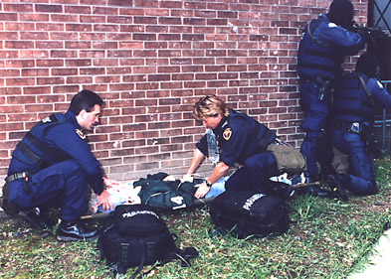
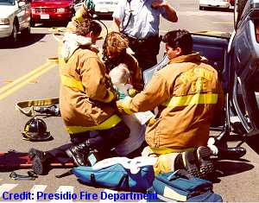
1st “P”
Preserve Life
- medical assistance

Slide 4
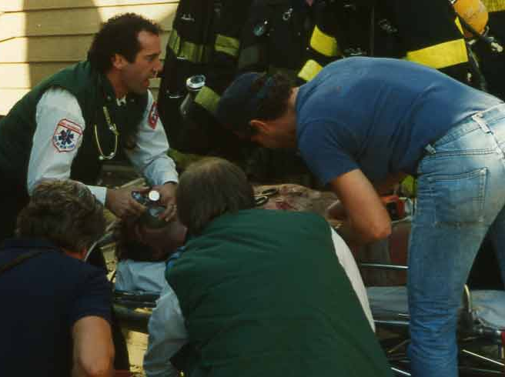
The number one priority is medical assistance to those injured at the scene; even if that means disturbance of possible evidence.
EMS (Emergency Medical Services) are trained in crime scene evidence preservation and are aware of possible destruction of evidence.

Slide 5
Crime Scene Preservation
Weatherford College EMS Professions Dept. Chair
Once the scene is secure by police, EMS should:
  Focus on emergency care.
  Touch only what you need.
  Move only that which must be moved.
  Observe and document anything unusual.
  Do not cut, remove, wash off, or cover anything that may be used as evidence later (unless emergency treatment requires this).
  Don’t cut through holes!
  Keep clothing and personal articles in paper bags
  Keep a log of who the clothing and personal articles and who were released to
  Note the description of the personal articles released

Slide 6
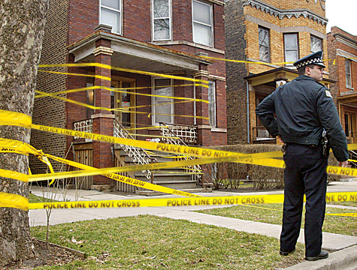
2nd“P”
Protect the scene
-rope off and/or barricade
-guards
-limit and document
people entering
the scene

Slide 7
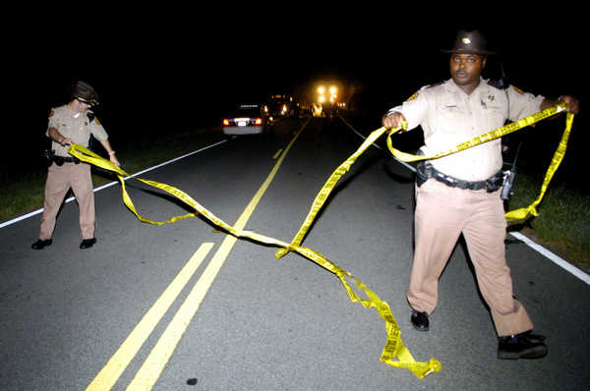
Why would you want to protect the scene?
Keep the evidence uncontaminated until it can be recorded and collected.
Every individual on the scene can destroy evidence (curious people, friends/family, cops (aka: The Fuzz))

Slide 8
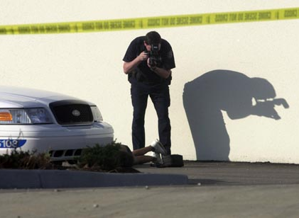
3rd “P”
Photograph

Slide 9
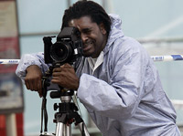
Photography
Unaltered condition! – before anything touched or removed
If evidence moved or removed, it must be noted (should not be reintroduced – Why?)
Comprehensive – every possible angle, close-ups of anything that may aid in solving the crime
Overlapping segments in one direction
After removal of the body, photograph surface
Videotaping

Slide 10
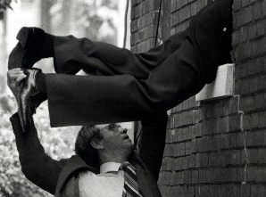
“S”
Search for evidence
Systematic & thorough

Slide 11
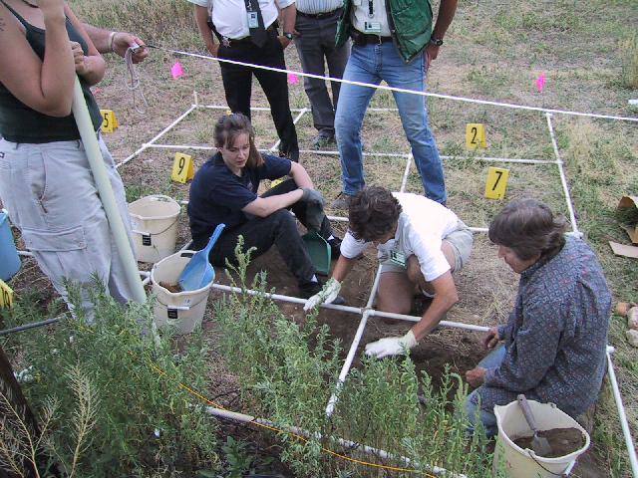
Recovering evidence at crime scene.

Slide 12
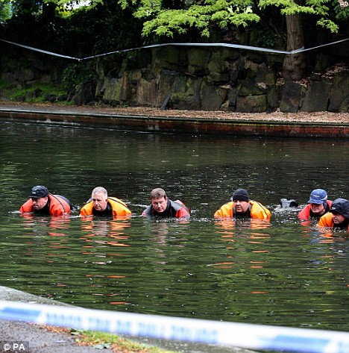
Police officers search the site of a murder

Slide 13
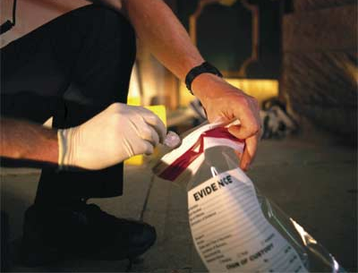

“C”
What is wrong with this picture?
Collect the evidence
Methodical -
Prevent contamination

Slide 14
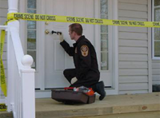
Each item must be placed in a separate container, sealed, and labeled
Most fragile is collected and packaged first
Different types of evidence require specific or special collection and packaging techniques

Slide 15
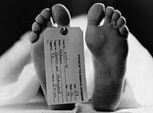
The body is the property of the coroner or medical examiner. The collection of evidence on the body is done by that department

Slide 16
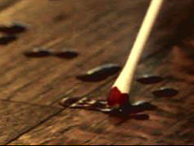
Collect enough of each piece of evidence for:
1) Tests done by the crime labs
2) Analysis for defense
3) Future review/retrial
Collect control samples – substances that may have been a contaminant
Ie- swab unstained area nearby

Slide 17
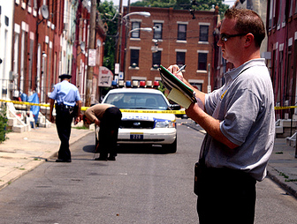
“R”
Record
Date - the date the evidence was collected.
Case # - the case number to which the evidence applies. This number is assigned by the lead investigator and should be unique for each incident investigated.
Consent Required - whether the investigation required the consent of the owner to search.
Signature of consenting person - if the consent was required, the signature of the owner.
Tag # - the unique number within the case number assigned to the evidence. These numbers are sequential for each piece of evidence in the case.
Description of item - a description of the evidence and any other pertinent notes.
Person receiving evidence - the name of the person collecting the evidence.
Signature - the signature of the person receiving the evidence.

Slide 18
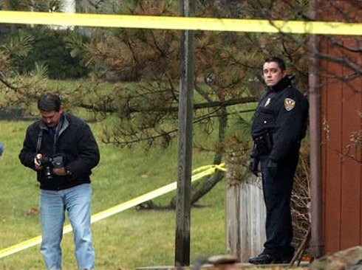
Notes
Date and time of photos
Camera positions for each picture should be recorded in the notes or on the crime scene sketch

Slide 19
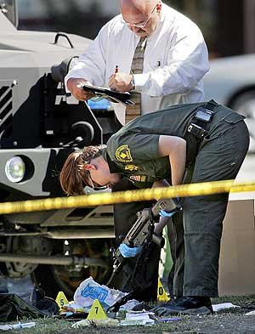
“The note taker has to keep in mind that this written record may be the only source of information for refreshing one’s memory months, perhaps years, after a crime has been processed. The notes must be sufficiently detailed to anticipate this need” – Saferstein

Slide 20
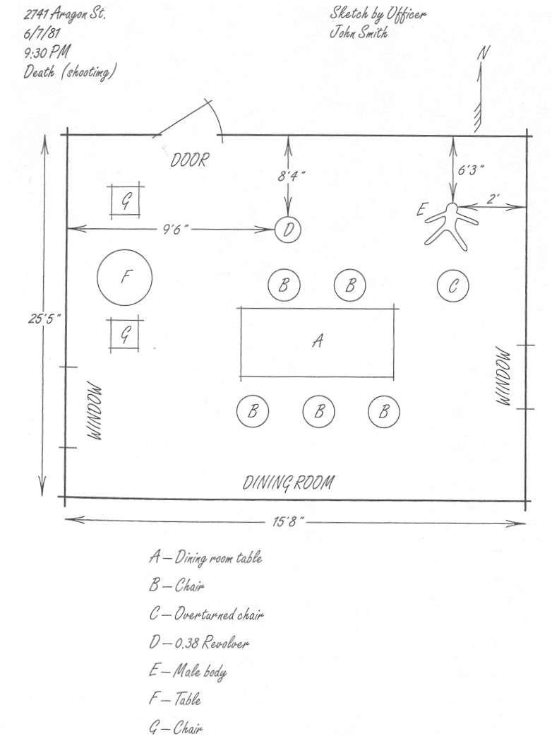

Slide 21
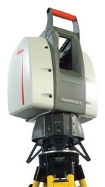
Leica Geosystem

Slide 22

“I”
Identify
-through collection and preliminary testing
-experienced investigators – know what is important at crime scene

Slide 23
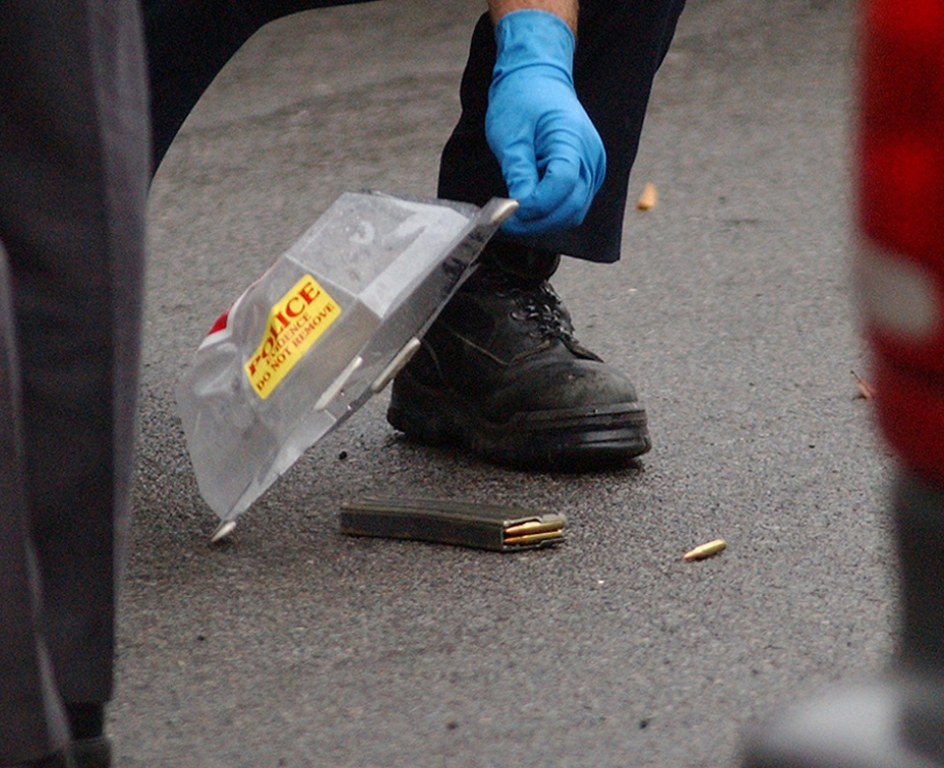
“P”
Package
-package separately
-Why would we package items separately?
do not want
cross
contamination

Slide 24
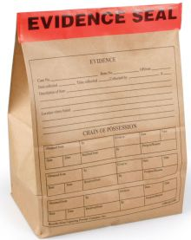
Protect by sealing
Investigators name/initials and date should be written across the seal

Slide 25
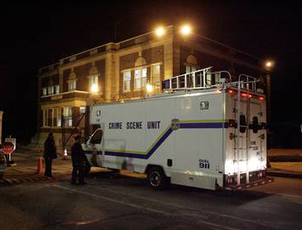
“T”
Transfer
- move evidence with care
ie- refrigerator on CS van, secure
evidence

Slide 26
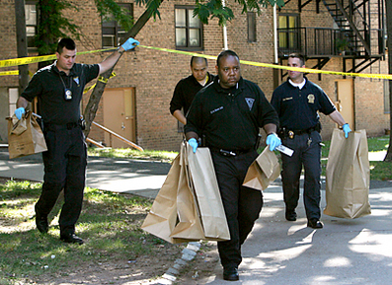
When transferring evidence what must we do?
List of all persons who came into contact with evidence

Slide 27
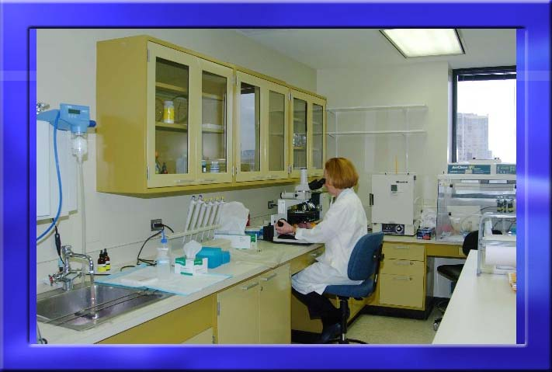
Final Destination

Slide 28

Questions?
Comments.
Complaints!

